Slide 1

Drowsiness
Detection
Mentored By- Mr.Ankur Chaturvedi
Department of Computer Engineering and Applications
GLA University, Mathura
Uttar Pradesh, India

Slide 2
SAMEEKSHA RATHI
01
YASH SRIVASTAVA
02
TEAM
MEMBERS
RIYA GAUR
03
MOHIT TIWARI
04
University Roll No- 181500611
University Roll No-181500829
University Roll No- 181500587
University Roll No- 181500392

Slide 3
Table of Content
Introduction
Statement of the Problem
•What is the specific theme and what is its originality?
•Motivation of the study
Objectives of the study
Methodology/ Models
•Dataset (if applicable)
•Step by step development as per objectives
Results/ Solutions
Limitations & Scope for future works
•Limitations
•Scope for future research
•Contributions
References

Slide 4
01
INTRODUCTION

Slide 5
Sleeping is one of the basic needs of the human being, sleep lack causes the body to react inefficiently, reducing both reaction time and wakefulness, also produce low alertness and loss of concentration which reduces the ability to perform activities based on care that is necessary in the case of driving a car.
The objective of this work is to implement a surveillance system to the vehicular driver in order to detect and alert when the driver have drowsiness signs. To achieve this objective, it was analysed other works related with detecting drowsiness in drivers, the drowsiness symptoms in vehicle drivers.

Slide 6
02
PROBLEM STATEMENT

Slide 7
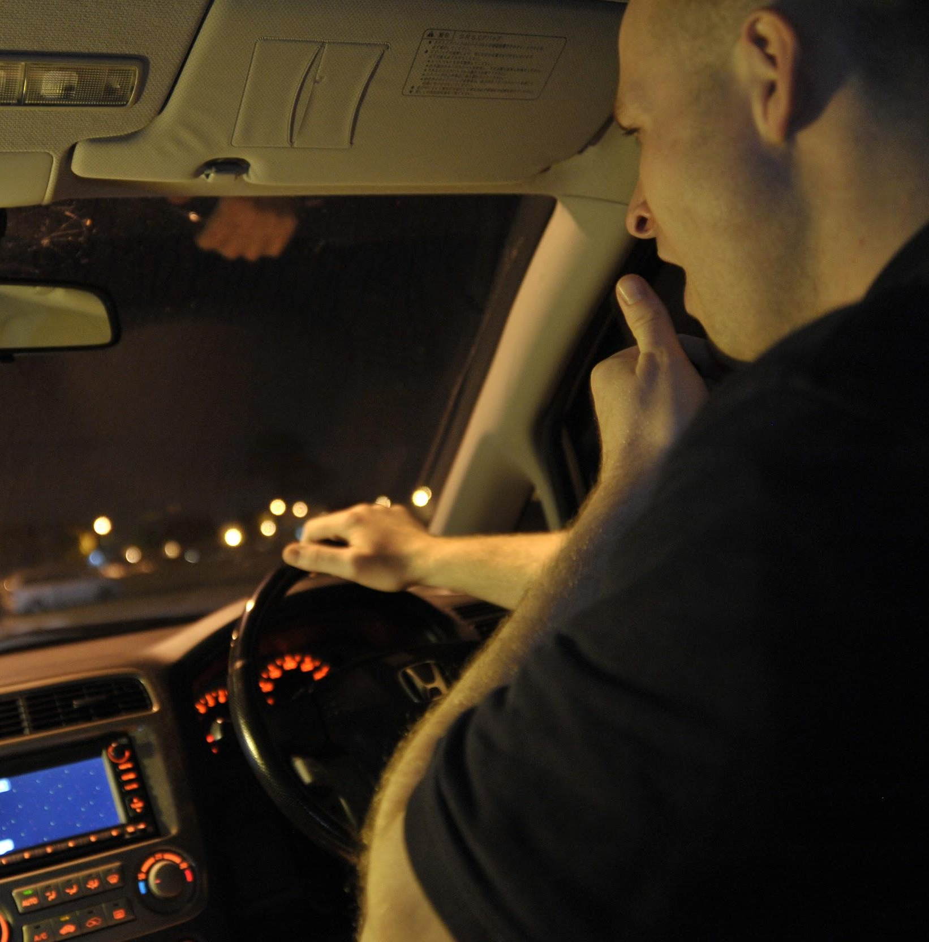
A countless number of people drive on the highway day and night. Taxi drivers, bus drivers, truck drivers and people traveling long-distance suffer from lack of sleep. Due to which it becomes very dangerous to drive while feeling sleepy.

Slide 8
MOTIVATION
Driver drowsiness is a significant factor in the increasing number of accidents on today’s roads and has been extensively accepted. This proof has been verified by many researchers that have demonstrated ties between driver drowsiness and road accidents. Although it is hard to decide the exact number of accidents due to drowsiness, it is much likely to be underestimated. The above statement shows the significance of a research with the objective of reducing the dangers of accidents anticipated to drowsiness. So far, researchers have tried to model the behaviour by creating links between drowsiness and certain indications related to the vehicle and to the driver.

Slide 9
03
OBJECTIVE

Slide 10
PREVENT ACCIDENTS
CREATE AWARENESS
MONITORING
TRAFFIC MANAGEMENT

Slide 11
04
METHODOLOGY

Slide 12
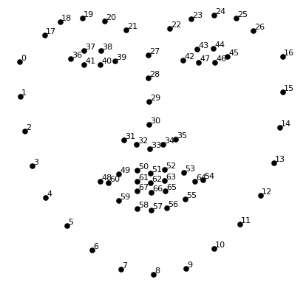
DATASET
This dataset is used to estimate the location of 68 coordinates (x, y) that map the facial points on a person’s face like image on the next slide.

Slide 13
STEP BY STEP DEVELOPMENT
Eye and Mouth Status Analysing
Alertness created
Real time Capturing
Drowsy Status Analysing
Drowsiness detected

Slide 14
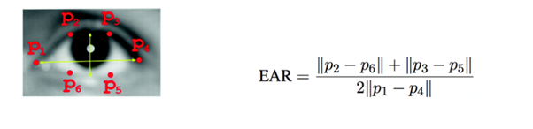
EYE ASPECT RATIO
The Eye Aspect Ratio is an estimate of the eye opening state.

Slide 15
05
RESULT

Slide 16
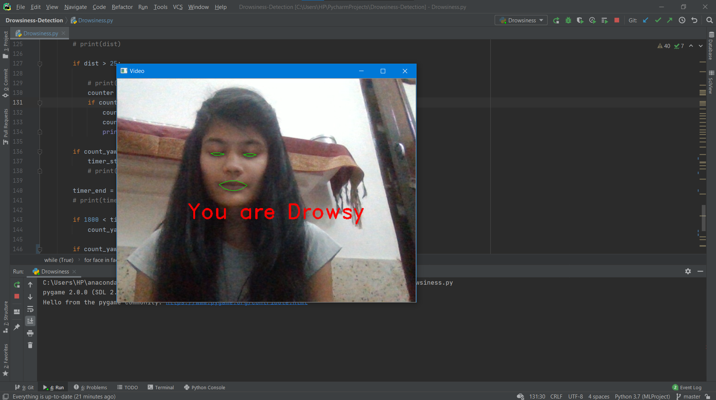
EYE DETECTION

Slide 17
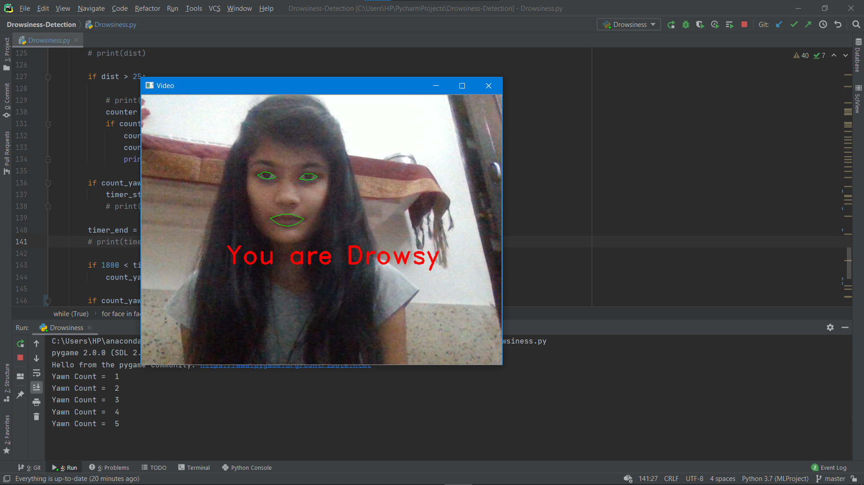
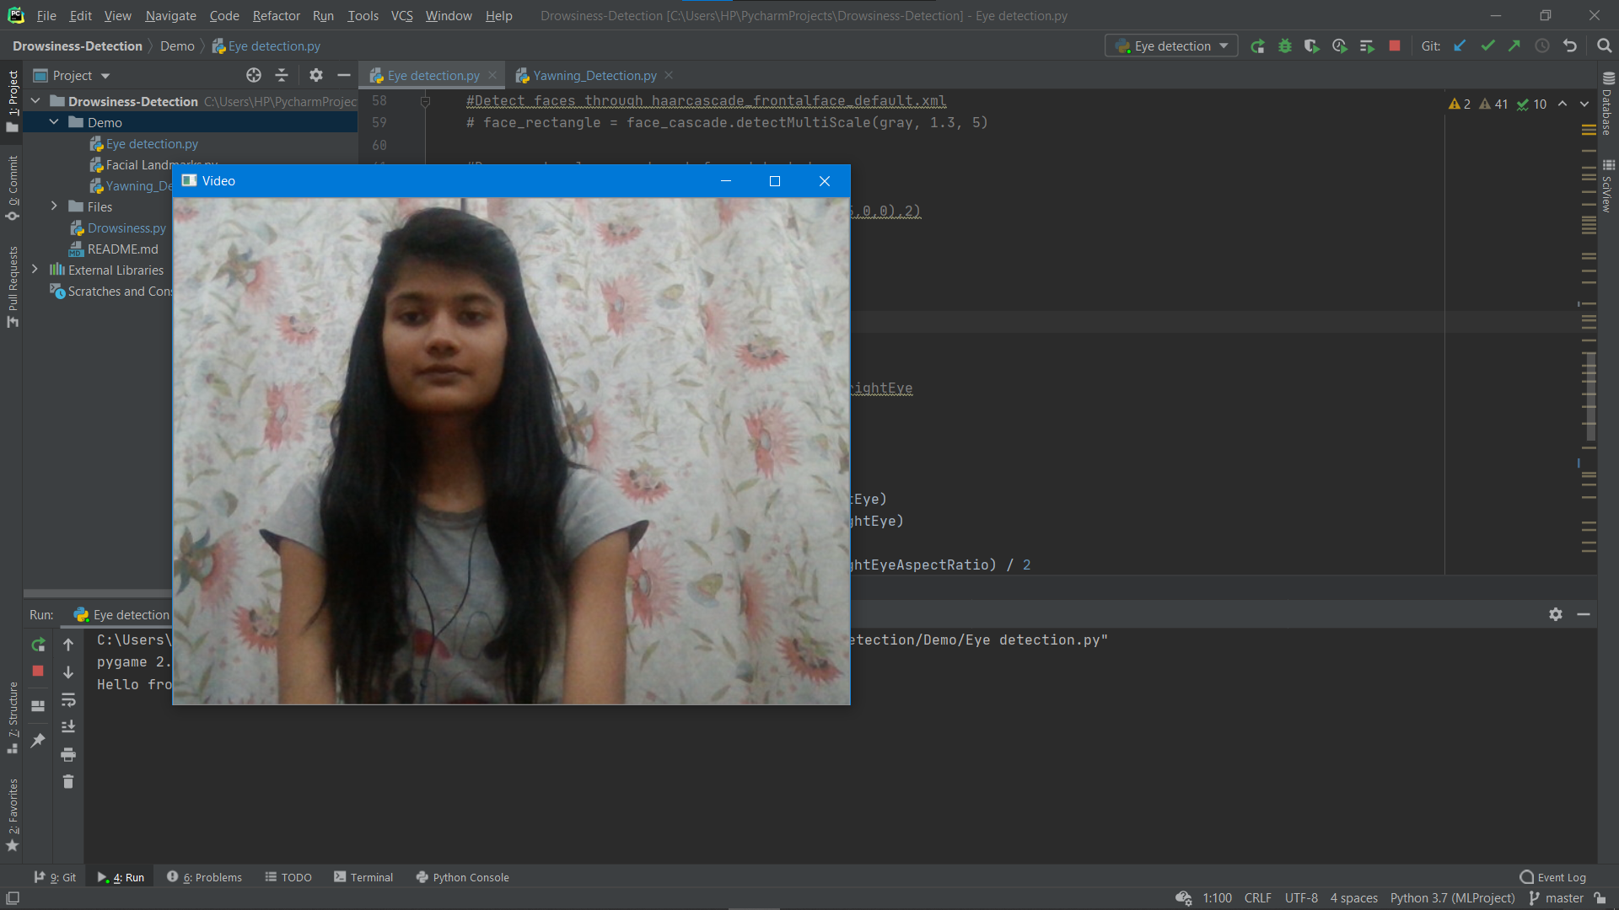
YAWN DETECTION

Slide 18
06
LIMITATIONS AND SCOPE

Slide 19
LIMITATIONS
Use of spectacles: In case the user uses spectacle then it is difficult to detect the state of the eye. As it hugely depends on light hence reflection of spectacles may give the output for a closed eye as opened eye. Hence for this purpose the closeness of eye to the camera is required to avoid light.
Multiple face problem: If multiple face arises in the window then the camera may detect more number of faces undesired output may appear. Because of different condition of different faces. So, we need to make sure that only the driver face come within the range of the camera. Also, the speed of detection reduces because of operation on multiple faces.

Slide 20
FUTURE SCOPE
The scope is to analyze whether it will detect the drowsiness completely or not, though it needs some improvisation but it will work.The future works may focus on the utilization of outer factors such as vehicle states, sleeping hours, weather conditions, mechanical data, etc, for fatigue measurement.

Slide 21
CONTRIBUTIONS
SAMEEKSHA RATHI
YASH SRIVASTAVA
MOHIT TIWARI
RIYA GAUR
Eye Detection
Eye Detection
Yawn Detection
Yawn Detection

Slide 22
07
REFERENCES

Slide 23
The following references were used in this project:
https://www.python.org
https://www.opencv.org
https://www.ijitee.org/wp-content/uploads/papers/v8i6s4/F11640486S419.pdf
https://www.geeksforgeeks.org
https://www.anaconda.org
https://www.jetbrains,com/pycharm/download/#section=windows
https://www.ijitee.org/wp-content/uploads/papers/v8i6s4/F11640486S419.pdf
Facial landmarks with dlib, OpenCV, and Python - PyImageSearch
https://www.researchgate.net/publication/336878674_DRIVER_DROWSINESS_DETECTION_SYSTEM
Facial landmarks with dlib, OpenCV, and Python - PyImageSearch

Slide 24
THANK YOU!
WE ARE OPEN FOR QUESTIONS!

